Slide 1
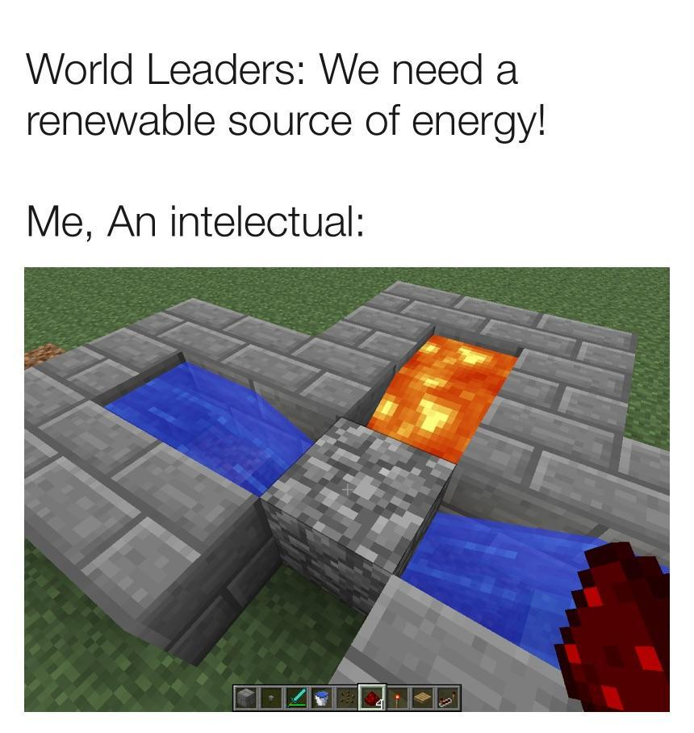
Solar Energy
Benjamin Dizdar, Marc Orihuela, Jameson McNamee, Kieran Egan

Slide 2
How does Solar Energy Work?
Photovoltaic cells are the most popular method of converting solar energy into electricity.
Photovoltaic effect is the creation of voltage and electric current in a material upon exposure to light. It is a physical and chemical phenomenon that is some ways is similar to the photoelectric effect.
Each cell is basically a sandwich comprised of two semi-conductors.
Phosphorous is added to the upper layer of the silicon panel, which adds extra electrons, with a negative charge.
Boron is added to the lower layer of the silicon panel, which results in few electrons, creating a positive charge.
This creates an electric field between the junction of the two panels.
When a photon of sunlight knocks an electron free, the electric field will repel that electron out of the junction, where it is later processed by other functions of the panel.

Slide 3
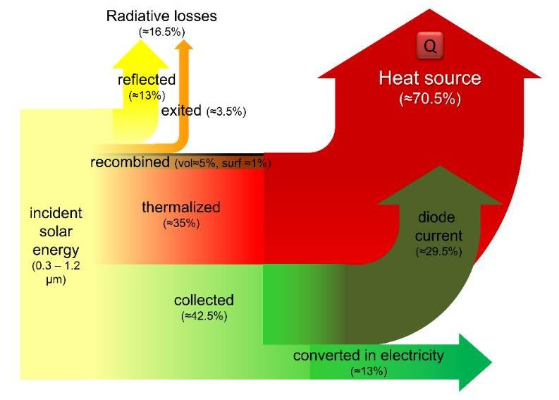
Sankey Diagram

Slide 4
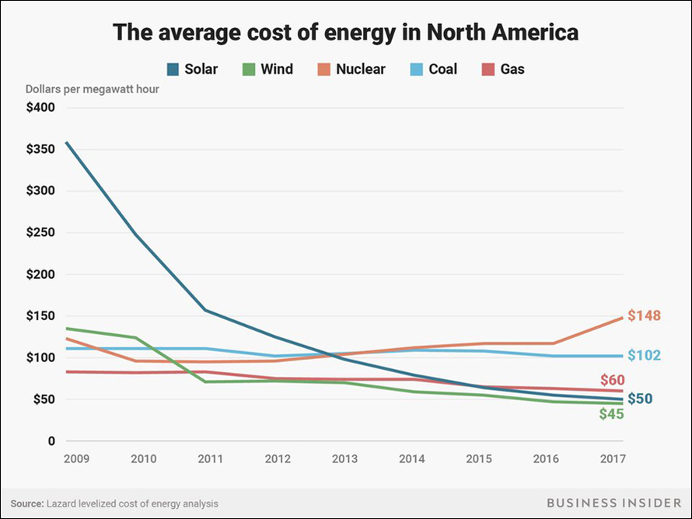
Advantages
The costs and efficiency of solar energy is rapidly decreasing
Solar energy has the second lowest average cost out of any of the major 5 energies.
It has a minimal effect on the environment outside of manufacturing
https://news.energysage.com/what-are-the-most-efficient-solar-panels-on-the-market/
http://solarcellcentral.com/cost_page.html
That’s right your presentation is useless :(

Slide 5
Disadvantages
Solar panels have a 15-20% efficiency
High initial cost
The start up of an average sized system (4kW to 8kW) costs between $15,000-30,000
Space intensive
13,600,000 acres or 21,250 square miles of solar panels to meet the total electricity requirements of the United States for a year.
Reliability
Since solar energy relies on the sun, electricity cannot be generated during the night, requiring you to either store excess energy made during the day, or connect to an alternate power source such as the local utility grid.

Slide 6
Environmental Impacts
Outside of manufacturing, solar energy has very few effects on the environment
Solar Energy is deemed the cleanest and most abundant renewable energy source
Solar energy’s common use in heating and cooling as well as electricity means it replaces fossil fuels such as coal, gas, and oil
Solar energy might hurt your pockets at first, but it sure won’t hurt the environment!

Slide 7
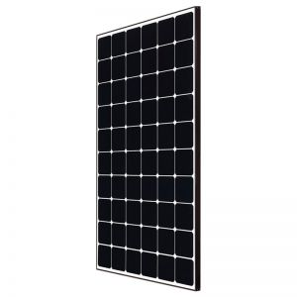
Cost Efficiency
3 main types of solar panels:
Thin FIlm (TF):
Efficiency = 7-13%
Cost = $0.50 to $1 per watt
Polycrystalline:
Efficiency = 13-17%
Cost = $0.90 to $1
Monocrystalline:
Efficiency = 15-22%
Cost = $1 to $1.50 per watt
Most efficient in the smallest amount of space
Monocrystalline Panel

Slide 8
Solving Problems in relation to Solar Energy
As technology advances, solar panels will become more and more efficient saving your money and the environment more
Right now, the most daunting thing about switching to solar energy is the initial cost
Again, as technology improves, new materials will become less costly and solar panels will require less surface area, saving money right off the bat
The United States government has already attempted a resolution to the money by providing rebates and embersements
Homeowners with solar energy also receive several tax benefits
Solar energy google

Slide 9
Some Sources
https://www.tandfonline.com/doi/full/10.1080/02604020903021776
https://www.nationalgeographic.org/encyclopedia/solar-energy/
https://www.britannica.com/science/solar-energy
https://www.eia.gov/energyexplained/solar/
https://www.sepco-solarlighting.com/blog/bid/115086/Solar-Power-Advantages-and-Disadvantages
https://www.nrel.gov/pv/cell-efficiency.html
https://www.seia.org/initiatives/about-solar-energy
https://archive.epa.gov/climatechange/kids/solutions/technologies/solar.html
http://lsa.colorado.edu/essence/texts/solar.html
https://news.energysage.com/what-are-the-most-efficient-solar-panels-on-the-market/
http://solarcellcentral.com/cost_page.html

Slide 10
Don’t use each other’s sources you apes
PS You actually can she said there can be some overlap. You just can’t have the same exact three.
U know ^ was Ben cause he used punctuation
JTizzle: https://www.seia.org/initiatives/about-solar-energy
Marc Sources:
https://www.eia.gov/energyexplained/solar/
https://us.sunpower.com/what-solar-energy-and-how-do-solar-panels-work
https://www.irena.org/solar
Yoooo we should definitely mention solar savings estimator that pops up when you look up solar energy on google
Kieran Sources:
Ben Sources:
https://www.britannica.com/science/solar-energy
https://www.nationalgeographic.org/encyclopedia/solar-energy/
http://lsa.colorado.edu/essence/texts/solar.html

